Slide 1

CSCI 4502/5502
Data Mining - Fall 2023 - Lecture 22
Ravi Starzl, PhD

Slide 2
Data Mining Trends and Research Frontiers
Ravi Starzl, PhD - Data Mining Fall 2023

Slide 3
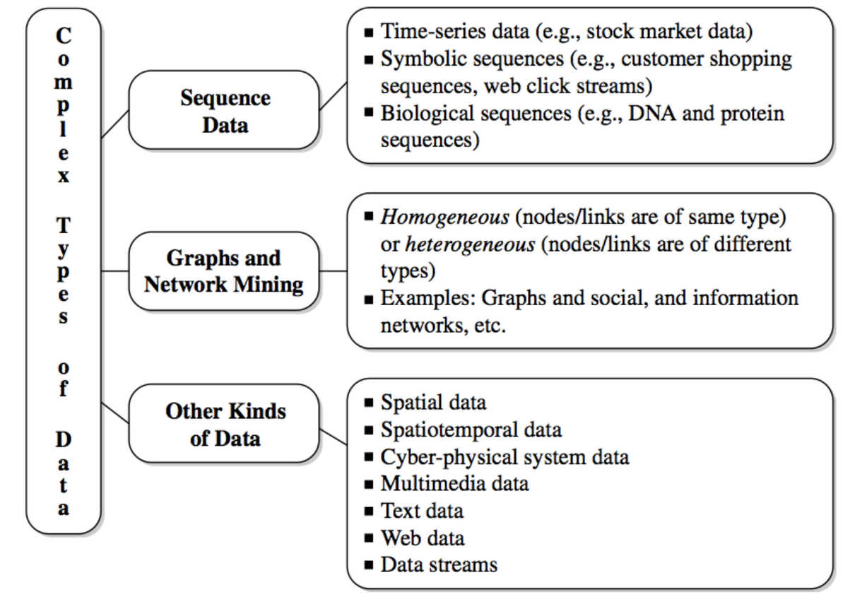
Data Mining Trends and Research Frontiers
Stream data
Sequence data
Graphs and networks
Multimedia, text, Web data
Ravi Starzl, PhD - Data Mining Fall 2023
Notes:
Stream data continuously flows from various sources like sensors, social media, or financial markets and is characterized by its high volume and need for real-time processing. This type of data presents challenges in managing its infinite length and rapidly changing nature, but is crucial for applications in real-time analytics and fraud detection.
Sequence data involves data points arranged in a specific order, which is significant in contexts like time series or biological sequences. Its main features include temporal order and dependency, with future data points often depending on previous ones. Analyzing sequence data can be challenging due to temporal correlations and variable lengths of sequences, but it is vital for forecasting, genetic pattern recognition, and speech recognition.
Graphs and networks depict data using nodes and edges to illustrate relationships, as seen in social networks or transportation systems. They are capable of modeling complex interconnections and can evolve over time. The challenges in this area include scalability and managing dynamic nature, with applications spanning social network analysis, route optimization, and network traffic analysis.
Multimedia, text, and web data consist of unstructured formats like images, videos, text, and web content. This data is diverse and information-rich, leading to challenges in handling its large volume and extracting meaningful insights. It is extensively used in image and speech recognition, web searching, and content recommendation.
Data mining trends and research frontiers are increasingly focusing on integrating machine learning for advanced predictive analyses and dealing with the complexities of big data. Important research areas include privacy preservation in data mining and the development of automated data analysis techniques. These advancements are enabling innovative applications in fields like healthcare, business intelligence, and the development of smart cities.

Slide 4
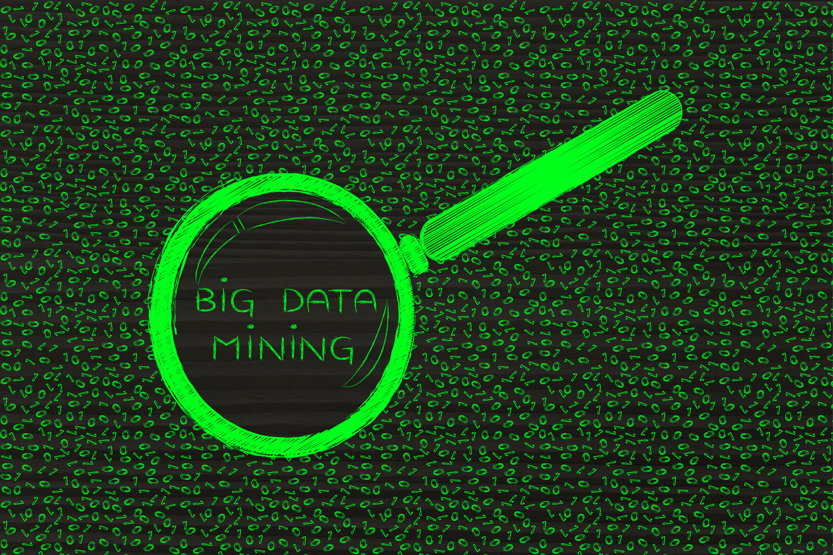
Mining Complex Data
Spatial data
Spatiotemporal data
Moving objects, trajectories
Cyber-physical systems
Ravi Starzl, PhD - Data Mining Fall 2023
Notes:
Mining complex data involves extracting valuable information from datasets that are not only large but also complex in terms of structure and content. This includes spatial data, spatiotemporal data, moving objects and their trajectories, and cyber-physical systems.
Spatial data refers to data that is associated with a specific location or geographical area. It is often represented in the form of coordinates, maps, or networks. The main challenge in mining spatial data lies in handling the complexities of geographical features and integrating them with other data types for meaningful analysis. This type of data is crucial for applications like urban planning, environmental monitoring, and location-based services.
Spatiotemporal data combines spatial data with temporal information, tracking changes to spatial elements over time. This data type is dynamic, as it reflects the movement and transformation of objects or phenomena in space and time. Analyzing spatiotemporal data is complex due to the need to simultaneously manage spatial relationships and temporal trends. It's widely used in fields such as weather forecasting, traffic management, and disaster response.
Moving objects and trajectories specifically focus on the paths that objects take over time in a spatial context. This involves tracking and analyzing the movement of entities, which can range from vehicles and wildlife to human beings. The key challenges include processing large volumes of trajectory data and extracting meaningful patterns from the movements. Applications are found in areas like transportation systems, wildlife tracking, and mobile communication networks.
Cyber-physical systems (CPS) represent a blend of physical processes and computational resources. These systems are characterized by their tight coupling of hardware and software, where physical processes are monitored and controlled by computer-based algorithms. Mining data from CPS is challenging due to the need to integrate and analyze data from both physical and digital sources. This is essential in applications like industrial automation, smart grids, and healthcare monitoring systems.

Slide 5

Statistical Data Mining
Regression: e.g., linear, multiple, weighted, polynomial, nonparametric
Generalized linear model: e.g., logistic regression, Poisson regression
Analysis of variance '
Mixed-effect analysis: grouped data
Factor analysis
Ravi Starzl, PhD - Data Mining Fall 2023
Notes:
Statistical data mining involves using statistical techniques to uncover patterns, correlations, and insights from large datasets. This process includes various methods such as regression analysis, generalized linear models, analysis of variance, mixed-effect analysis, and factor analysis.
Regression Analysis:
Types:
Linear Regression: Estimates the relationship between a dependent variable and one independent variable using a straight line.
Multiple Regression: Extends linear regression by using multiple independent variables to predict a dependent variable.
Weighted Regression: Assigns different weights to data points, often used when data points vary in their reliability.
Polynomial Regression: Fits a non-linear relationship between the independent and dependent variables using polynomial functions.
Nonparametric Regression: Useful when there is no specific form or model to describe the relationship between variables.
Application: Used in predicting outcomes, trend analysis, and understanding relationships between variables.
Generalized Linear Model (GLM):
Types:
Logistic Regression: Used when the dependent variable is binary. It predicts the probability of occurrence of an event by fitting data to a logistic curve.
Poisson Regression: Used for modeling count data and contingency tables. It's appropriate for modeling the rate of occurrence of events.
Application: Employed in fields like epidemiology, economic modeling, and social sciences for predicting categorical outcomes.
Analysis of Variance (ANOVA):
Purpose: Tests the differences between means of different groups or variables.
Application: Commonly used in experimental designs to examine the influence of independent variables on a dependent variable.
Mixed-Effect Analysis:
Focus: Deals with grouped data or hierarchical data structures.
Application: Useful in fields such as education, where data might be grouped by school, or in medical studies with patients from different clinics.
Factor Analysis:
Objective: Identifies underlying variables, or factors, that explain the pattern of correlations within a set of observed variables.
Application: Widely used in psychology, social sciences, and market research to discover underlying themes or features in a dataset.

Slide 6

Data Mining Foundations
Data reduction
Data compression
Probability and statistical theory
Microeconomic view: utility
Pattern discovery and inductive database
Ravi Starzl, PhD - Data Mining Fall 2023
Notes:
Data Mining Foundations include various essential techniques and theories crucial for effective data analysis and knowledge discovery.
Data reduction simplifies data by reducing its volume while maintaining analytical integrity. This enhances the efficiency of data mining algorithms and reduces storage and analysis costs. Data compression focuses on reducing data size through efficient encoding, saving storage space and speeding up data transmission.
Probability and statistical theory provide a framework for modeling uncertainty and variability in data. These are foundational for making inferences, hypothesis testing, and developing prediction models. Understanding these theories is crucial for identifying patterns and trends within the data.
In the context of data mining, the microeconomic view of utility refers to the value or usefulness of the information extracted. This perspective assesses the economic benefits of data mining projects and guides decision-making, considering the cost of mining against the value of the information.
Pattern discovery involves identifying meaningful patterns, correlations, or anomalies within data. Inductive databases integrate data storage with inductive data mining capabilities, allowing for more efficient and effective analysis. This facilitates the exploration and querying of patterns, streamlining data mining processes.
Collectively, these foundational elements provide the necessary tools and theoretical understanding for professionals to design and implement robust data mining solutions.

Slide 7

Visual and Audio Data Mining
Data visualization
Data mining result visualization
Data mining process visualization
Interactive visual data mining
Audio data mining
Ravi Starzl, PhD - Data Mining Fall 2023
Notes:
Visual and Audio Data Mining focus on extracting meaningful information from visual and auditory data sources, employing techniques for both data representation and analysis.
In Visual Data Mining, data visualization is a key aspect. It involves representing data in graphical formats like charts, graphs, and maps to help users understand complex data patterns and relationships easily. This approach is not just about presenting data but also about uncovering hidden patterns within the data.
Data mining result visualization goes a step further by specifically focusing on representing the outcomes of data mining algorithms. This involves visualizing patterns, trends, and anomalies identified during the data mining process, making it easier for users to interpret and understand the results.
Data mining process visualization is concerned with representing the actual data mining process. This includes visualizing the workflow and the various steps involved in the mining process, from data preparation to algorithm application and result interpretation. This visualization aids in understanding and optimizing the mining process.
Interactive visual data mining integrates interactivity with data visualization, allowing users to directly engage with the data. Users can manipulate visual representations, explore different views of the data, and make real-time adjustments to the mining process. This approach enhances the exploration and discovery process, making it more user-centric and intuitive.
Audio Data Mining involves analyzing and extracting meaningful information from audio data. This can include speech recognition, music classification, and environmental sound analysis. The challenges in audio data mining include handling diverse audio formats, extracting relevant features, and interpreting complex audio signals. Applications are found in fields like digital forensics, healthcare (e.g., heart sound analysis), and entertainment (e.g., music recommendation systems).

Slide 8
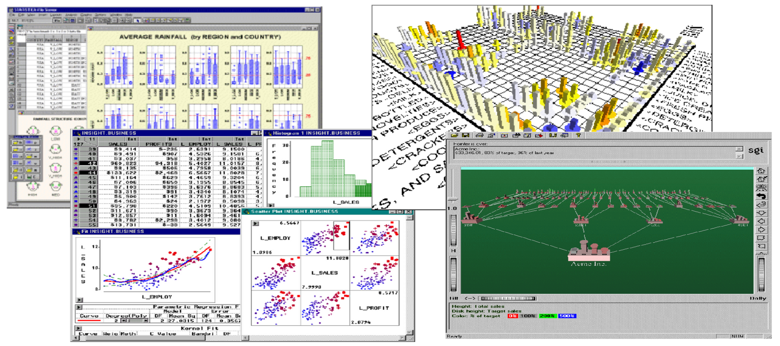
Examples
Ravi Starzl, PhD - Data Mining Fall 2023

Slide 9

Audio Data Mining
An inverse task of mining audio data
Use audio signals to indicate data patterns or features of data mining results
An interesting alternative to visual data mining
Transform patterns into sound and music, listen to pitches, rhythms, tune, and melody in order to identify anything interesting or unusual
Ravi Starzl, PhD - Data Mining Fall 2023
Notes:
Audio Data Mining is an innovative approach that uses auditory techniques to analyze and interpret data. It's considered an inverse task of traditional data mining, which typically relies on visual methods.
In this process, audio signals are used to indicate data patterns or highlight features of data mining results. Instead of visualizing data through graphs or charts, audio data mining transforms data patterns into sound. This transformation can involve converting data points into various auditory elements like pitches, rhythms, tunes, and melodies.
This method offers an interesting alternative to visual data mining, especially useful for users with visual impairments or in scenarios where visual representation is not practical. By listening to the audio representations of data, users can identify interesting or unusual patterns. For example, a sudden change in pitch or rhythm might indicate an anomaly in the data, while a harmonious melody might represent a regular pattern.
Audio data mining involves a creative process of mapping data attributes to sound properties. For instance, a higher pitch could represent a higher value in the dataset, or a change in rhythm could indicate a change in the trend of the data.
This approach is particularly valuable in fields like finance for monitoring stock market trends, in healthcare for analyzing patterns in medical data, or in environmental studies for detecting changes in ecological data. It provides a unique way to explore and understand complex datasets, making data analysis more accessible and engaging.

Slide 10

Data Mining Applications
Gap between generic data mining techniques and effective and scalable data mining tools for domain-specific applications
Some application domains of data mining
financial data analysis
retail and telecommunication industries
science and engineering
intrusion detection and prevention
recommender systems, ...
Ravi Starzl, PhD - Data Mining Fall 2023
Notes:
Data Mining Applications span a wide array of fields, each with its unique challenges and requirements. While there are numerous generic data mining techniques available, there's often a gap when it comes to developing effective and scalable tools tailored for specific domain applications. This gap arises due to the unique nature of data and specific objectives in different domains.
In the **financial data analysis** domain, data mining is used to uncover patterns in stock market trends, credit scoring, risk management, and fraud detection. The challenge lies in handling the vast amount of financial data and ensuring accurate, timely analysis for decision-making.
In the **retail and telecommunication industries**, data mining helps in customer relationship management, predicting customer behavior, optimizing product placements, and enhancing service offerings. The key challenge is to manage and analyze the large customer databases effectively.
In **science and engineering**, data mining aids in processing large datasets from experiments or simulations. It's used for discovering patterns in scientific data and improving engineering processes. The challenge is the complexity and variety of the data.
**Intrusion detection and prevention** systems use data mining to identify unusual patterns or anomalies that could signify security threats. The difficulty here lies in accurately distinguishing between normal and potentially harmful activities without generating too many false alarms.
**Recommender systems** leverage data mining to analyze user preferences and behavior, providing personalized recommendations in various sectors like e-commerce, entertainment, and content platforms. The challenge is to provide accurate and relevant recommendations in real-time, considering the vast amount of data and the evolving preferences of users.
In all these applications, the main challenge is to bridge the gap between generic data mining methodologies and the development of specialized tools that can handle the specific requirements of each domain effectively and efficiently. This involves not only technical expertise in data mining algorithms but also a deep understanding of the domain-specific challenges and data characteristics.

Slide 11

Financial Data Analysis
Data collected in banks & financial institutions
Relatively complete, reliable, and of high quality
Data warehouse for multi-dimensional data analysis and data mining
Loan payment prediction, consumer credit
Target marketing: classification, clustering
Detection of money laundering and other financial crimes
Ravi Starzl, PhD - Data Mining Fall 2023
Notes:
Data Mining Applications span a wide array of fields, each with its unique challenges and requirements. While there are numerous generic data mining techniques available, there's often a gap when it comes to developing effective and scalable tools tailored for specific domain applications. This gap arises due to the unique nature of data and specific objectives in different domains.
In the financial data analysis domain, data mining is used to uncover patterns in stock market trends, credit scoring, risk management, and fraud detection. The challenge lies in handling the vast amount of financial data and ensuring accurate, timely analysis for decision-making.
In the retail and telecommunication industries, data mining helps in customer relationship management, predicting customer behavior, optimizing product placements, and enhancing service offerings. The key challenge is to manage and analyze the large customer databases effectively.
In science and engineering, data mining aids in processing large datasets from experiments or simulations. It's used for discovering patterns in scientific data and improving engineering processes. The challenge is the complexity and variety of the data.
Intrusion detection and prevention systems use data mining to identify unusual patterns or anomalies that could signify security threats. The difficulty here lies in accurately distinguishing between normal and potentially harmful activities without generating too many false alarms.
Recommender systems leverage data mining to analyze user preferences and behavior, providing personalized recommendations in various sectors like e-commerce, entertainment, and content platforms. The challenge is to provide accurate and relevant recommendations in real-time, considering the vast amount of data and the evolving preferences of users.
In all these applications, the main challenge is to bridge the gap between generic data mining methodologies and the development of specialized tools that can handle the specific requirements of each domain effectively and efficiently. This involves not only technical expertise in data mining algorithms but also a deep understanding of the domain-specific challenges and data characteristics.

Slide 12

Retail & Telecomm. Industries
Retail industry: huge amounts of data on sales, consumer shopping history, ecommerce, etc.
Applications
buying behaviors, shopping patterns, trends
customer service, retention, satisfaction
goods transportation and distribution
product recommendation, ...
Telecomm. and many other industries: Share many similar goals & expectations
Ravi Starzl, PhD - Data Mining Fall 2023
Notes:
In the retail industry, data mining is extensively used to analyze vast amounts of information about sales, consumer shopping history, and e-commerce activities. This analysis helps in understanding buying behaviors, identifying shopping patterns and trends, which are crucial for inventory management, marketing, and strategic planning. Retailers utilize data mining to enhance customer service, focusing on retention and satisfaction by analyzing customer feedback and service records. Additionally, it plays a key role in optimizing goods transportation and distribution, ensuring efficient supply chain management. Retailers also leverage data mining for product recommendation systems, offering personalized shopping experiences to customers, thereby increasing sales and customer loyalty.
The telecommunications industry, sharing many similar goals with retail, also harnesses data mining to understand customer behavior, such as service usage patterns and preferences. This insight is vital for developing tailored service plans and reducing churn rates. Telecommunication companies use data mining to optimize their network performance, analyzing traffic data to reduce congestion and improve service quality. Fraud detection is another critical application, where unusual patterns in data are analyzed to identify potential fraudulent activities. Furthermore, data mining aids in creating targeted marketing campaigns, using customer data to increase engagement and conversion rates.

Slide 13

Science and Engineering
Data warehouse, data preprocessing
Mining complex data types
Graph/network based data mining
Visualization tools and domain knowledge
Examples
social science and social studies: text, social media
computer science: monitoring systems, software bugs, network intrusion
Ravi Starzl, PhD - Data Mining Fall 2023
Notes:
In the fields of science and engineering, data mining plays a pivotal role in managing and analyzing large and complex datasets. The use of data warehouses and data preprocessing is fundamental in these sectors. Data warehouses store vast amounts of data, providing an efficient platform for analysis, while data preprocessing involves cleaning and preparing data for mining, ensuring accuracy and relevance in the analysis.
Mining complex data types in science and engineering involves dealing with various forms of data, such as text, images, and sensor data. This process often requires sophisticated algorithms to extract meaningful information from complex and sometimes unstructured data sources.
Graph or network-based data mining is particularly significant in these fields. It involves analyzing relationships and patterns within data that is best represented as a graph or network, such as molecular structures in chemistry or social networks in social science.
Visualization tools combined with domain knowledge are essential in these areas. Visualization tools help in representing complex data and analysis results in a more understandable and interpretable form. Domain knowledge, on the other hand, is crucial for making sense of the data and for guiding the data mining process towards relevant and significant outcomes.
In the realm of social science and social studies, data mining applications include analyzing text and social media data. This involves studying communication patterns, public opinion, and social behavior. Text mining and sentiment analysis are commonly used techniques in this area.
In computer science, data mining is applied in monitoring systems to track performance and detect anomalies. It's also used in identifying software bugs by analyzing code repositories and bug reports. Additionally, network intrusion detection is another critical application, where data mining helps in identifying patterns that suggest security breaches or malicious activities within computer networks.

Slide 14

Intrusion Detection and Prevention
Signature-based detection
attack patterns that are preconfigured and predetermined by domain experts
Anomaly-based detection
build profiles (of normal behavior) and detect ones that are substantially different
Data mining approaches
discriminative pattern analysis & classifiers, distributed data mining, visualization
Ravi Starzl, PhD - Data Mining Fall 2023
Notes:
Intrusion Detection and Prevention systems are crucial in cybersecurity, focusing on identifying and mitigating unauthorized access or attacks on network systems. Two primary approaches are used in these systems: signature-based detection and anomaly-based detection, each with its unique methodology and application of data mining techniques.
Signature-based detection relies on known attack patterns that are preconfigured and predetermined by domain experts. In this approach, the system scans for specific signatures or patterns of known malicious activities, such as viruses, worms, or trojans. This method is effective for detecting known threats but may not identify new or unknown attacks. Data mining in signature-based detection involves analyzing large datasets of known attack patterns and updating the signature database to recognize new variants of known malware.
Anomaly-based detection, in contrast, involves building profiles of normal behavior and then detecting activities that deviate substantially from these norms. This method is capable of identifying previously unknown threats by looking for anomalies or unusual patterns in network traffic, user behavior, or system operations. Data mining techniques are crucial here for establishing what constitutes normal behavior and for the real-time analysis of data to spot anomalies.
Data mining approaches in intrusion detection and prevention include discriminative pattern analysis and classifiers, distributed data mining, and visualization. Discriminative pattern analysis and classifiers are used to categorize network activities as normal or malicious based on learned patterns. Distributed data mining is particularly important in large-scale networks where data is collected from multiple points; it involves aggregating and analyzing data from these various sources to detect intrusion attempts. Visualization tools in data mining help security experts to quickly understand and identify potential threats by presenting complex data patterns in a more interpretable and accessible format.
The application of data mining in intrusion detection and prevention is a dynamic field, constantly evolving with the emergence of new threats and the development of more sophisticated analysis techniques. These systems are integral to maintaining the security and integrity of computer networks in an increasingly connected world.

Slide 15

Recommender Systems
Personalization, group-based
Approaches
content-based, collaborative filtering, hybrid
Data mining and recommender systems
memory-based methods: k-nearest neighbor
model based: probabilistic models, clustering, classification, Bayesian network, ...
ensemble
Ravi Starzl, PhD - Data Mining Fall 2023
Notes:
Recommender Systems are sophisticated tools used to predict and suggest items to users based on their preferences and behaviors. These systems can be personalized for individual users or tailored for groups. They employ various approaches and data mining techniques to provide accurate and relevant recommendations.
**Approaches to Recommender Systems:**
1. **Content-Based:** These systems recommend items similar to those a user has liked in the past. They analyze the properties of items and use this information to suggest new items with similar attributes.
2. **Collaborative Filtering:** This approach makes recommendations based on the preferences of other users who have similar tastes. It doesn't require item metadata and instead relies on user-item interactions.
3. **Hybrid Systems:** These combine content-based and collaborative filtering methods, potentially overcoming the limitations of each approach and improving recommendation quality.
**Data Mining in Recommender Systems:**
1. **Memory-Based Methods (such as k-nearest neighbor):** These methods involve finding a set of users or items that are most similar to the target user or item, and making recommendations based on this neighborhood. They are relatively simple to implement and understand.
2. **Model-Based Approaches:** These involve building predictive models to estimate user preferences. Examples include:
- **Probabilistic Models:** Use statistical methods to predict user preferences.
- **Clustering:** Groups similar users or items together to make recommendations.
- **Classification:** Categorizes users or items and uses these classifications to make suggestions.
- **Bayesian Networks:** Utilize probabilistic graphical models to infer user preferences.
3. **Ensemble Methods:** Combine different models or algorithms to improve the accuracy and robustness of recommendations. These methods can leverage the strengths of multiple approaches to provide more reliable suggestions.
Recommender systems, especially in the context of e-commerce, streaming services, and content platforms, have become essential in enhancing user experience and engagement. The use of data mining techniques in these systems allows for the analysis of large volumes of complex data, enabling more personalized and accurate recommendations. As technology evolves, these systems continue to become more sophisticated, incorporating advanced machine learning algorithms and artificial intelligence to further refine their recommendations.

Slide 16

Privacy, Security, Social Impacts
Non-personal data
meteorology, astronomy, geography, geology, biology, ...
Statistically significant patterns vs. individual patterns
Method 1: de-identification
Method 2: enhancing data security
Method 3: privacy-preserving data mining
Notes:
In data mining, particularly when dealing with non-personal data from areas like meteorology, astronomy, geography, geology, and biology, the focus is on uncovering broad patterns rather than individual specifics. This approach demands methods that ensure privacy and security while facilitating significant discoveries.
De-identification is a common method where personal identifiers are removed from data sets. This is especially relevant in situations where individual identification isn't necessary for analysis, such as in large-scale environmental or astronomical data studies.
Enhancing data security is another critical aspect. It involves implementing robust security measures like encryption and secure data handling protocols to protect data from unauthorized access and breaches. This is vital across all fields of data mining to maintain data integrity and confidentiality.
Privacy-preserving data mining is an advanced approach that develops methods for analyzing data without directly accessing sensitive information. Techniques like differential privacy and homomorphic encryption are employed here. This method is crucial for maintaining privacy while extracting valuable insights from data, particularly in fields where data sensitivity is high.
These methods collectively aim to balance the potential of data mining in advancing scientific and practical knowledge with the ethical responsibility of protecting privacy and ensuring data security. As technology evolves, so do the methods to safeguard data while exploiting its analytical potential.

Slide 17

Trends of Data Mining (1)
Application exploration
Scalable and interactive data mining
Integration of data mining with Web search engines, DBS, data warehouse, cloud computing, ...
Social and information networks
Spatiotemporal, moving objects, CPS
Multimedia, text, Web data
Notes:
Trends in Data Mining reflect the continuous evolution of technology and the growing complexity of data. Application exploration is a key trend, focusing on identifying new domains and challenges where data mining can be applied. As data is generated in vast quantities across various sectors, there's a growing need for innovative applications of data mining.
Scalable and interactive data mining is crucial due to the increasing size of datasets. This trend is about developing algorithms and systems capable of efficiently handling large datasets and allowing user interaction for more customized outcomes.
The integration of data mining with web search engines, databases, data warehouses, cloud computing, and other technologies is becoming more prevalent. This integration enhances the analytical capabilities of these systems, facilitating sophisticated data analysis and improved decision-making processes.
Mining social and information networks has become significant with the surge in data from social media and online platforms. Analyzing this data provides insights into social behavior, information flow, and user interactions.
Spatiotemporal data mining, along with the analysis of moving objects and cyber-physical systems (CPS), is another growing area. It deals with data that incorporates geographical, temporal, and physical dimensions, offering insights into the movement of objects and changes in environmental conditions.
The mining of multimedia, text, and web data is increasingly important due to the proliferation of digital content. This trend involves the analysis of diverse data types, including images, videos, text, and web data, to uncover valuable information and discern patterns.

Slide 18

Trends of Data Mining (2)
Biological and biomedical data
Software engineering, system engineering
Visual and audio data mining
Distributed data mining and real-time data stream mining
Privacy protection and information security in data mining
Notes:
Biological and Biomedical Data Mining has become increasingly important due to the vast amounts of data generated in these fields. This involves analyzing genomic, proteomic, and various other types of biological data to uncover patterns that can lead to medical breakthroughs and a better understanding of biological processes.
In Software and System Engineering, data mining is applied to improve the development process, enhance system performance, and identify potential issues. Mining software repositories, bug reports, and system logs helps in predicting system failures, understanding user requirements, and improving software quality.
Visual and Audio Data Mining is a rapidly growing area, focusing on extracting information from visual and auditory data sources. This includes analyzing images, videos, and audio recordings to detect patterns and gain insights. This trend is particularly prominent in fields like digital media, surveillance, and user interface design.
Distributed Data Mining and Real-Time Data Stream Mining address the challenges of analyzing data distributed across multiple locations or streaming data in real-time. This is crucial in scenarios like network security, where real-time analysis of data streams is required to detect threats, or in large-scale sensor networks used in environmental monitoring.
Privacy Protection and Information Security in Data Mining have become paramount due to increasing concerns about data breaches and the ethical use of data. This involves developing techniques that allow data mining while ensuring the privacy of individuals and the security of the data being analyzed. Techniques like anonymization, encryption, and secure multi-party computation are key in addressing these concerns.

